Slide 1



Employee Management System
Course: SEN 182
Group 7
A web-based Employee Management System built using HTML, CSS, and JavaScript

Slide 2


Introduction
An Employee Management System is a website used to manage employee information, roles, and activities efficiently.

Slide 3

Objectives
• Maintain employee records
• Track employee status
• Improve administrative efficiency
• Provide user-friendly interface

Slide 4
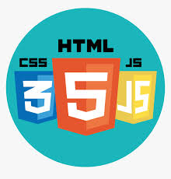
Technologies Used
• HTML (Structure)
• CSS (Design & Layout)
• JavaScript (Interactivity & Logic)

Slide 5

Key Features
• Add, edit, and delete employees
• Dashboard with employee data
• Active/Inactive status toggle
• Search and filter employees

Slide 6

System Design
• Sidebar navigation
• Dashboard overview
• Employee table/list
• Responsive UI design

